Slide 1
ai AGENT FOR DIGITAL FINANCIAL LITERACY
IBM HACKATHON PROJECT
Presented By:
Student name : Shreya
College Name : Maharaja Surajmal Institite
Department : BCA

Slide 2
OUTLINE
Problem Statement
Technology used
Wow factor
End users
Result
Conclusion
Git-hub Link
Future scope
IBM Certifications

Slide 3
Problem Statement
Problem:
Many people, especially in rural and non-tech-savvy communities, lack awareness and confidence in using digital financial tools like UPI, online banking, or budgeting platforms. This gap leads to financial exclusion, increased vulnerability to online frauds, and poor money management.
Proposed Solution:
Develop an AI-powered Digital Financial Literacy Agent using IBM Cloud Lite and IBM Granite, integrated with Retrieval-Augmented Generation (RAG).The agent will:Provide accurate, real-time answers sourced from trusted financial authorities (RBI, SEBI, NPCI, etc.)

Slide 4
Technology used
IBM cloud lite services
Natural Language Processing (NLP)
Retrieval Augmented Generation (RAG)
IBM Granite model

Slide 5
IBM cloud services used
IBM Cloud Watsonx AI Studio
IBM Cloud Watsonx AI runtime
IBM Cloud Agent Lab
IBM Granite foundation model

Slide 6
Wow factors
This AI agent simplifies digital finance for every Indian by making financial literacy accessible, personalized, and secure — powered by IBM Cloud Lite and IBM Granite.
Unique Features:
🔍 RAG-powered responses from RBI, SEBI, NPCI, and government sites
🌐 Multilingual support for Hindi, Tamil, Bengali, and more
🔐 Fraud alerts & scam prevention guidance
💰 Personalized budgeting and loan guidance
🧠 Step-by-step UPI, mobile banking, and interest rate explanations
☁️ Fast, scalable, and private – backed by IBM infrastructure

Slide 7
End users
General Public (Urban & Rural)
Students & Young Adults
Senior Citizens
First-time Digital Finance Users
Educational Institutions

Slide 8
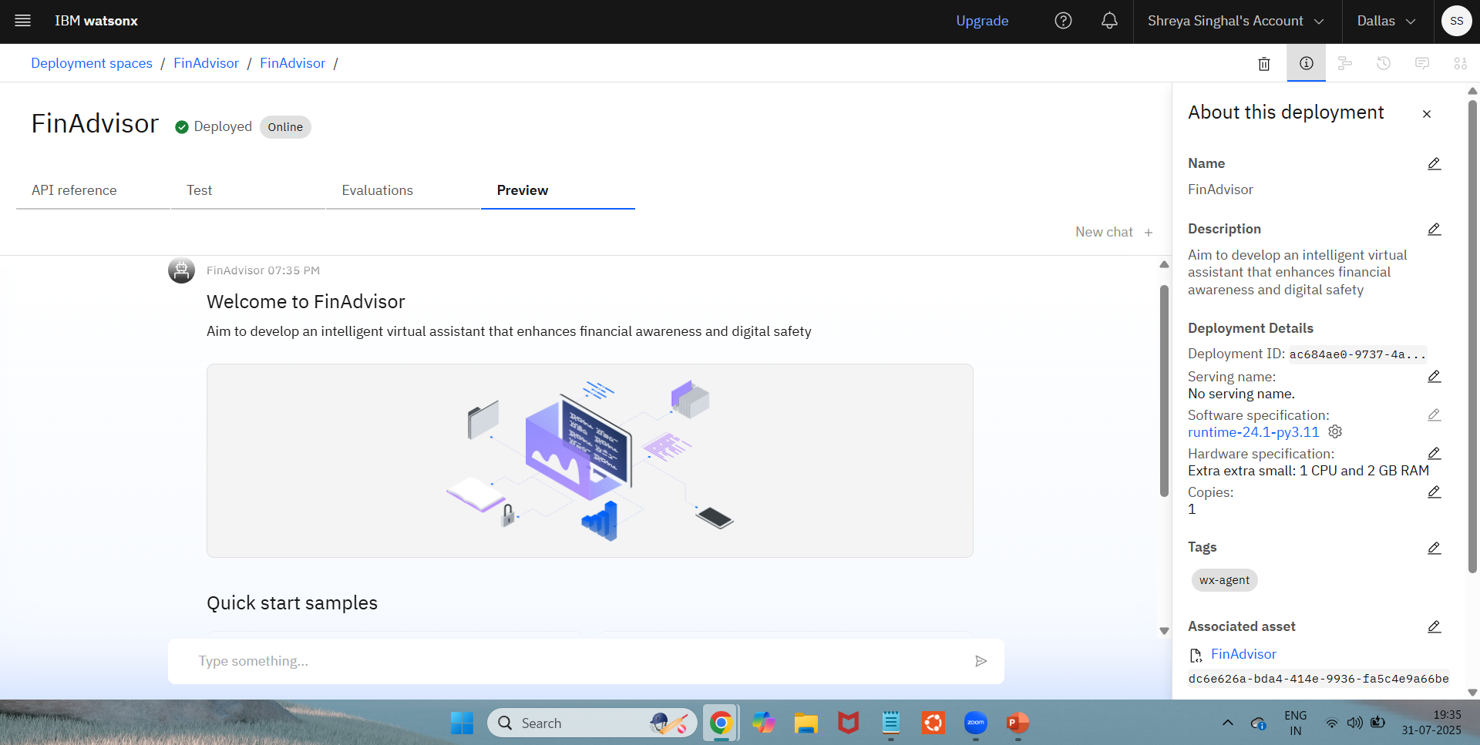
Results

Slide 9
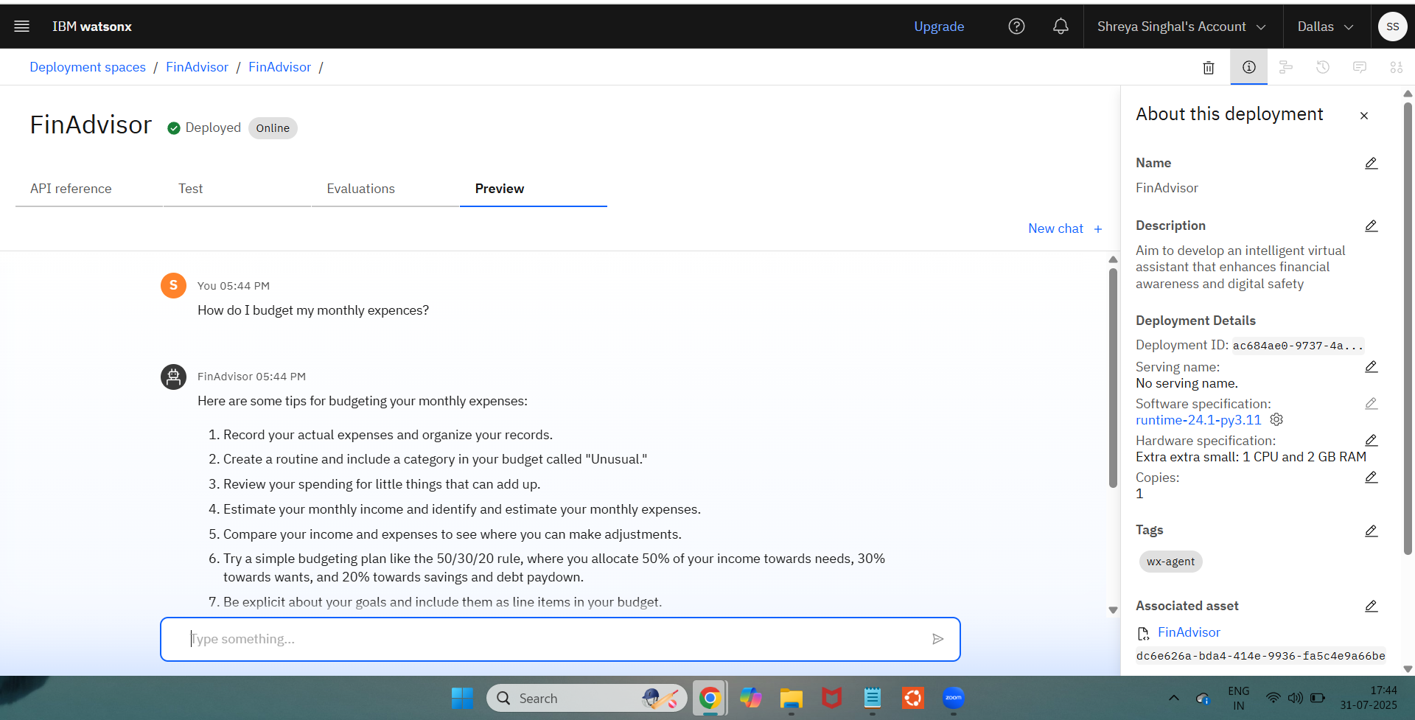
Results

Slide 10
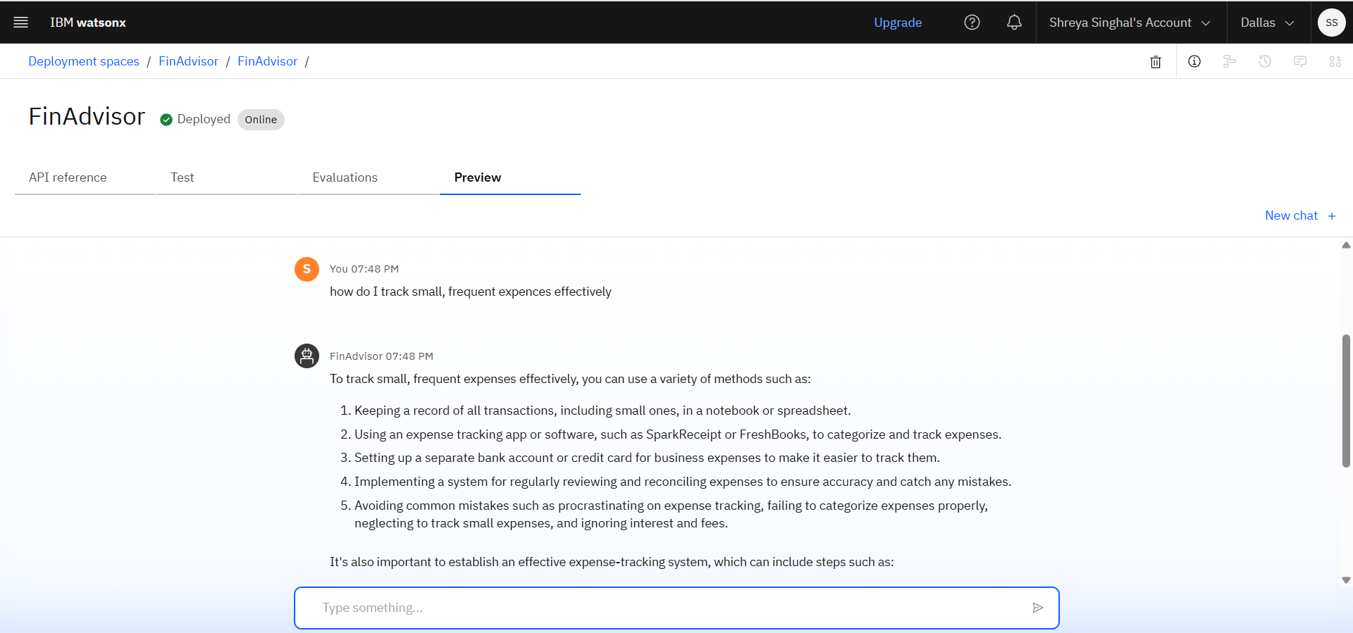
Results

Slide 11
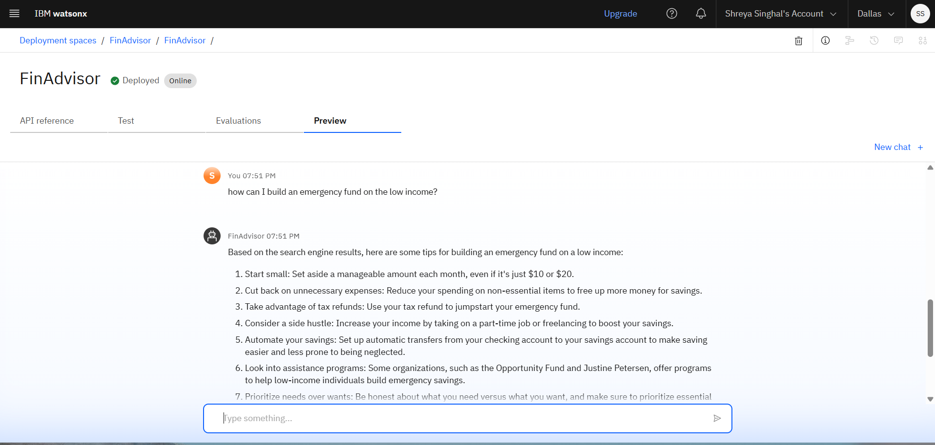
Results
Deployed AI Agent

Slide 12
Conclusion
The AI Agent for Digital Financial Literacy is a transformative solution designed to make digital finance safe, simple, and inclusive for everyone.
By combining RAG-based AI, multilingual support, and trusted financial sources, this agent empowers users to:
Make informed financial decisions
Stay safe from online scams
Gain confidence in using digital tools like UPI and online banking
With future advancements, this agent has the potential to become a universal financial mentor—bridging the gap between people and digital financial systems.

Slide 13
GitHub Link
https://github.com/Shreya0521dev/IBM-cloud-Finance-Advisor-AI-agent

Slide 14
Future scope
The AI Agent will continue evolving to empower users with advanced financial knowledge and tools:
🤖 Integration with voice assistants (Alexa, Google Assistant) for hands-free access
🏦 Direct API linkages with banks for personalized finance suggestions
📈 AI-driven investment education and portfolio simulation for beginners
📊 Regional financial data insights for rural and urban segments
📚 Partnership with educational institutions for financial literacy campaigns
🔄 Continuous learning using user feedback and new financial regulations

Slide 15
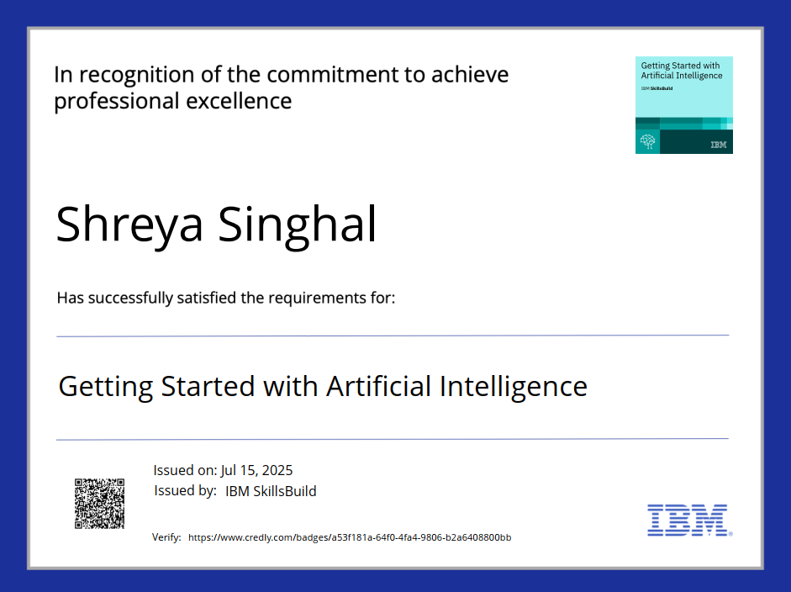
IBM Certifications
credly certificate( getting started with AI)

Slide 16
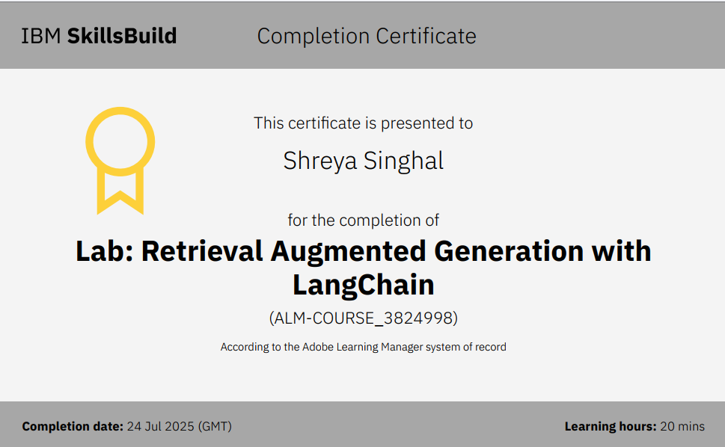
RAG LAB certificate

Slide 17
THANK YOU

